Slide 1
COST Action no. FA1301
A network for improvement of cephalopod welfare husbandry in research, aquaculture and fisheries (CephsInAction)
Food and Agriculture (FA)
Participating countries
AT, BG, DE, EL, ES, FR, fYR Macedonia HR, IE, IL, IT, ME, MT, NL, NO, PT, UK
2013 ⏐ 2017
Objectives
Implement general guidelines and experimental practices for cephalopods; accumulate data to improve and refine codes of practice for the use of cephalopods in research
Improvement of species-specific best practices and development of new technologies, including not-invasive approaches to improve research on cephalopods welfare
Development of new technologies and experimental approaches to promote the 3Rs principle
Coordination of on-going national research projects and new proposals (CoRP)
Provide proper training on experimental practices, procedures also to facilitate Dissemination
The goal of CephsInAction is to facilitate scientific cooperation and dissemination of knowledge to promote
multi-disciplinary research on cephalopods biology
Contact details
Chair of the Action Dr. Giovanna Ponte, PhD
Director of Operations, CephRes - Italy
g_ponte@cephalopodresearch.org
Science Officer
Dr. Ioanna Stavridou, PhD Science Officer Food and Agriculture COST Office
ioanna.stavridou@cost.eu
Action Website www.cephsinaction.org
Domain website:
www.cost.eu/fa

Slide 2
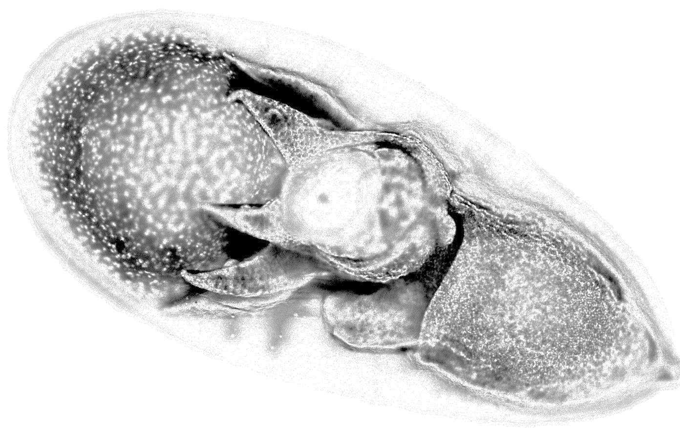
Working Group activities
Working Group 1. Research Needs in Cephalopods Welfare
Assess best laboratory practices to implement the 3Rs principle to cephalopods for experimental, training and display purposes
Review Optimal and Species-Specific Rearing Conditions, including environmental and nutritional factors
Assess environmental needs for different Cephalopod Species for increasing Welfare of the animals
Working Group 2. Stress & Diseases
Evaluate Signs and Indicators of Stress, Pain, Suffering and Immune Response
Classify, Diagnose and Prevent Diseases in Cephalopods
Explore Non-Invasive Methods to Assess the Health Conditions in Live Individuals
Working Group 3. Neurophysiology, Anaesthesia and Humane-End-Points
Evaluate the Existent Protocols in Neurophysiology and Behavioral Pharmacology to Verify Applicability and Standardize Methodology
Promote Research on the Effects of Common Anesthetic Agents and Explore Alternatives
Evaluate Humane-End-Points, Euthanasia Practices and Criteria for Death Confirmation
Explore Non-Invasive Methods for Assessing Physiological status of the animals
Working Group 4. Development of a Cephalopod Welfare Index Model (CWIM)
Characterization of Welfare Indicators (Integration of data from other WGs)
Develop Overall Assessment of Welfare (OWA) by semantic modeling to develop a Cephalopod Welfare Index Model (CWIM)
Working Group 5. Education and Training
Dissemination and Training activities
Development of Educational material including audiovisual alternatives (inspired to NORINA Database of Alternatives)
Industry participation
FujiFilm VisualSonics Amsterdam, The Netherlands
www.visualsonics.com
AquaBioTech Group Mosta, Malta
www.aquabt.com
Octopus vulgaris embryo, stage XVI

